Slide 1

Rapido Cab Analysis
Presentation
BY Ghadge Sarvesh Tukaram

Slide 2
Project Overview
The Rapido Ride Analytics project is based on a synthetic dataset with over 3,000 ride records, 500 users and 300 drivers, combined into three relational tables; these tables are: rapido1,rapido_drivers2, and rapido_rides_with_names3 which record variables such as fare, distance, drop-off and pickup locations, the name of the user and the name of the driver.
The analysis starts with user behavior and engagement. Specifically, it involved looking at the counts of rides taken, total fare spent, and distances travelled.
Driver performance analysis is another significant aspect. By joining ride data with driver profiles, we computed the earnings for each driver, the average fare per ride for each driver, and the ride counts.
The analyses on routes and locations were of particular operational value. We were able to look at zero-based pickup and drop locations which had the highest count and revenue. Some route combinations, for example, "Koramangala to Marathahalli" or "HSR to BTM" had high demand and high revenue earners.
Revenue Analysis is a primary part of the Rapido Ride Analytics project, which aimed to understand revenue generation from several perspectives - the platform level, per driver, per user, per route, and by time period.
By using the rapido_rides_with_names table to join with rapido_users and rapido_drivers, we were able to determine both individual and aggregate fare totals giving us the complete picture of how the revenue flows through the system.

Slide 3
Project analysis slide 3
Problem Statement
With the continued expansion of urban mobility platforms like Rapido, the need for data-driven decision making to manage operations, improve customer experience, and increase profitability is becoming more necessary. While raw ride data can support strategic decision making, it lacks the industry standards for structuring operational data and sufficient revenue or rider insights needed for thoughtful planning. Rapido also struggles with understanding its performance around revenue, user engagement, driver performance, and demand trends by location.
Lack of structured insights from ride data prevents Rapido from making informed business decisions.
User engagement patterns (e.g., frequent riders, high spenders) are not being tracked or utilized effectively
Driver performance and efficiency metrics are not identified, making it hard to recognize top drivers or those needing support.
Location and route-based demand trends are not well understood, which limits route optimization and driver placement.

Slide 4
Project analysis slide 4
Project Analysis Table
Rapido1
Rapido_drivers_2
Rapido_rides_with_name 3
Create tabal Rapido1(
User_id text,
Name text,
Phone bigint
Email text
Signup_date text
Ride_id text
User_id text
Driver_id text
Pickup_location text
Drop_location text
Fare double
Distance_km double
Ride_time text
User_name text
Driver_name text
Driver_id text
Name text
Vehical_number text
Ratings double

Slide 5


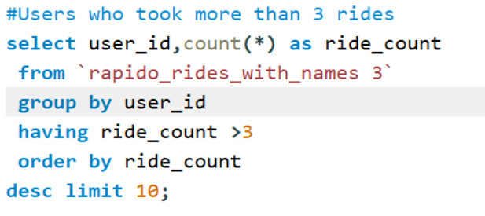
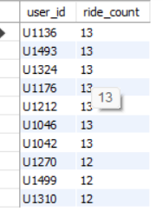
Project analysis slide 5
User Analysis

Slide 6
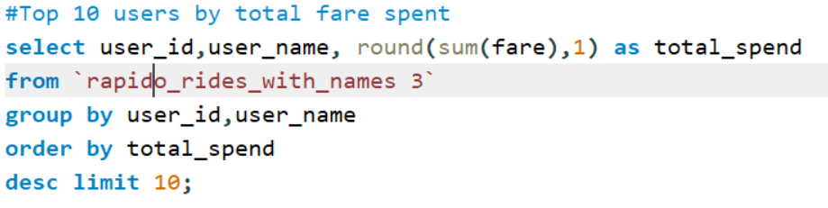
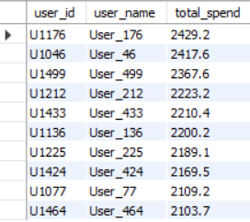
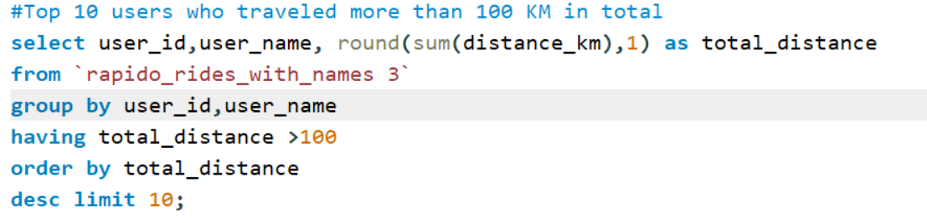
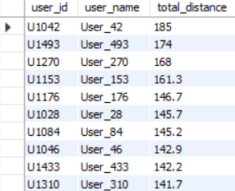
Project analysis slide 6

Slide 7


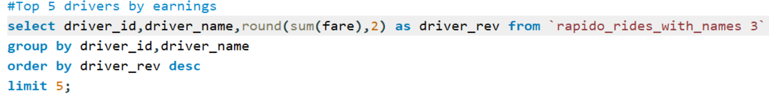
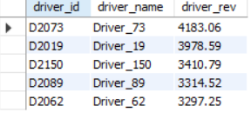
Project analysis slide 7
Driver Analysis

Slide 8
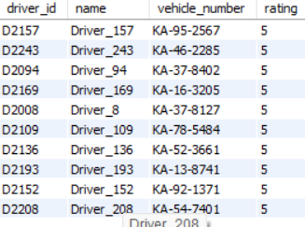
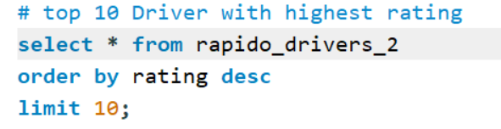
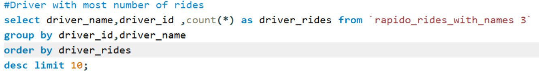
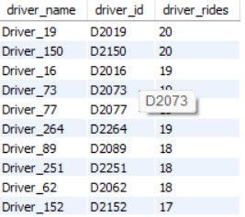
Project analysis slide 8

Slide 9
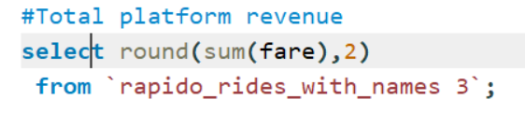

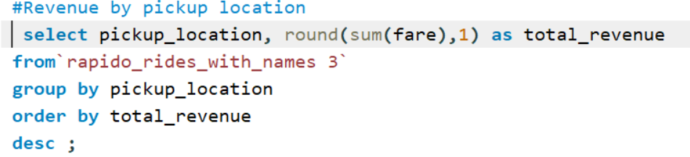
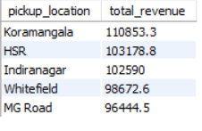
Project analysis slide 10
Revenue Analysis

Slide 10
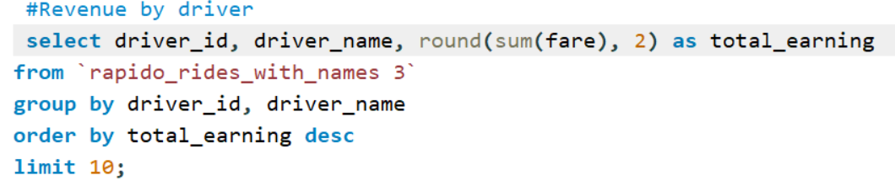
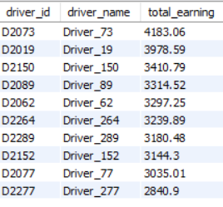
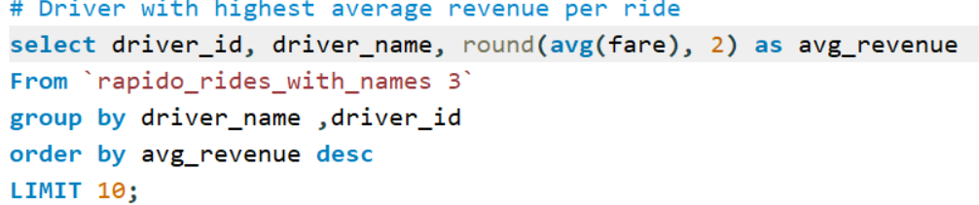
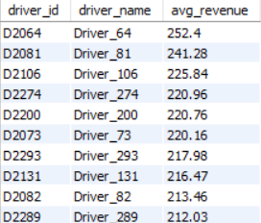

Slide 11
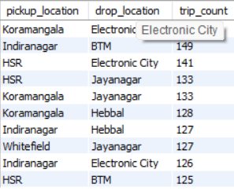
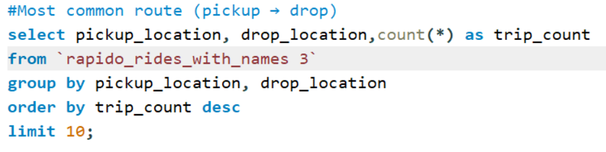
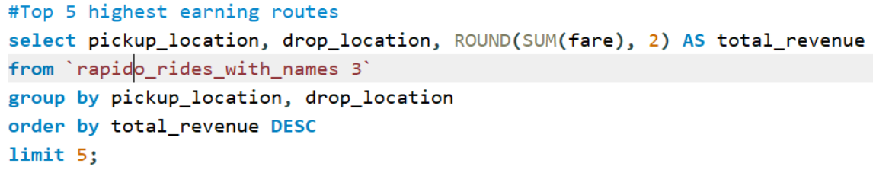
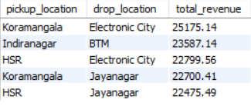
Route Analysis

Slide 12
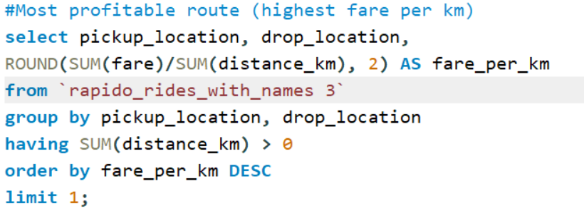

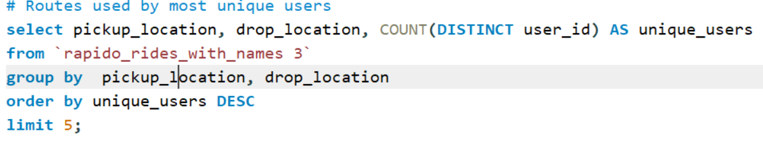
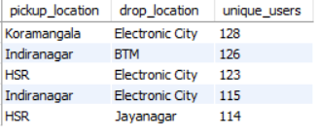

Slide 13
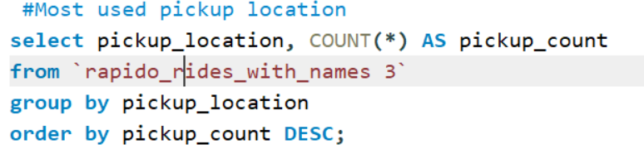
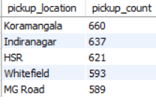
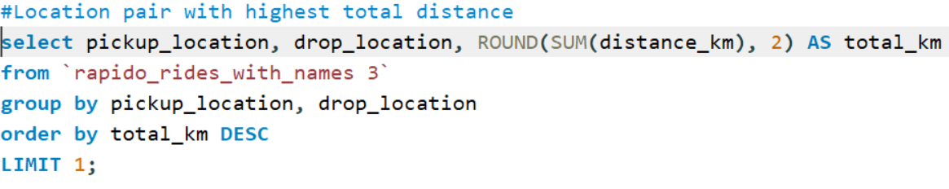

Location Analysis

Slide 14
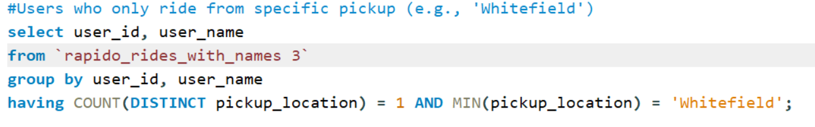

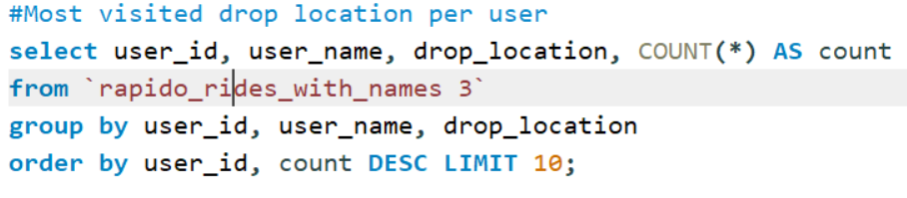
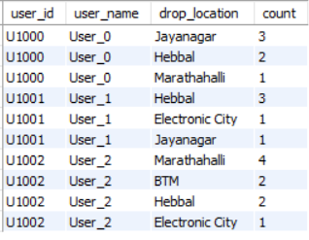

Slide 15
Thank You

